Slide 1
100 MEN Enterprise Presents
2023 Empowerment Symposium
Forest Hill Church of Christ Classroom
3916 Forest Hill Circle
Forest Hill, Texas, 76140
Presenter - Emanuel White Sr.
Saturday
10 AM
F R E E
9 | 16 | 2023
10AM – 11:30AM
Forest Hill Church of Christ Classroom
3916 Forest Hill Circle
Forest Hill, Texas 76140
@100men.net

Slide 2
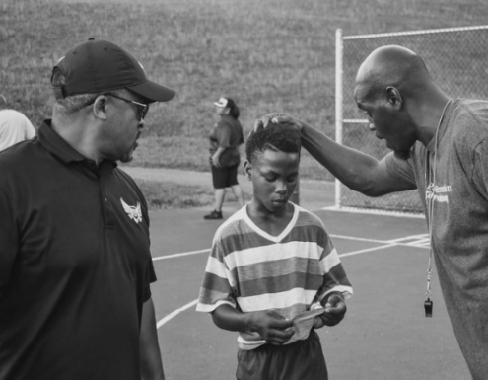
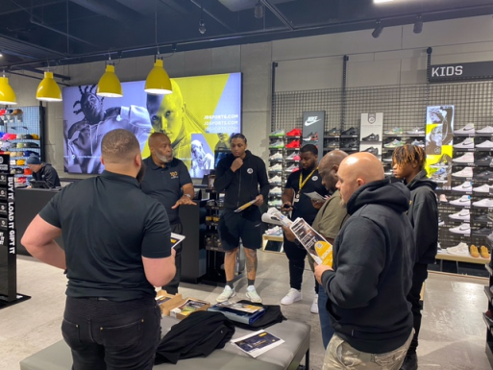
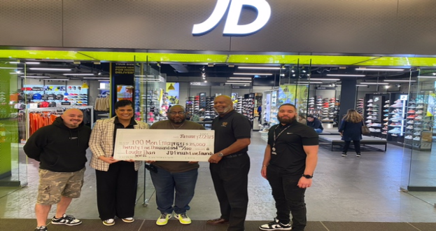
2023 100 MEN Empowerment Schedule
10:00AM - 11:30AM
Contact Us at…
Dallas
West Dallas Multipurpose Ctr. 2828 Fish Trap Rd, Dallas, Texas, 75212
100men.net
Raymond L. Pitts / CEO rpitts@onehundredmen.com Mobile: 817-905-7961
Forest Hill
Forest Hill COC, 3916 Forest Hill Circle Forest Hill, Texas, 76140
Presenters
Presenter | 15-Jul | 5-Aug | 19-Aug | 16-Sep | 30-Sep | 14-Oct | 4-Nov | 2-Dec | 9-Dec
Alfred Dixon | Dallas |  |  |  | Dallas |  |  |  | Dallas
Desiree Bailey |  | Dallas |  |  |  | Dallas | F Hill
Emanuel White Sr. | F Hill |  |  | F Hill |  | F Hill |  |  | F Hill
Jasmine Holiday |  |  | F Hill |  | Dallas
LaJohn McDonald |  |  | Dallas |  |  |  |  | Dallas
Monica Simpson |  |  | Dallas |  |  |  | F Hill | Dallas
Terry Jenkins | Dallas | Dallas
Wyndell Madkins |  |  |  |  |  | F Hill |  |  | Dallas
Alfred Dixon | – Dallas Regional Director (7/15, 9/30, 12/9)
Desiree Bailey | – Public Relations (8/5, 10/14, 11/4)
Emanuel White Sr. | – CEO Brotherhood of Men (7/15, 9/16, 10/14, 12/9)
Jasmine Holiday | – Financial Planning (8/19, 9/30)
LaJohn McDonald | – Men’s Mental Health (8/19, 12/2)
Monica Simpson | – The make up of Men (Anger & Frustrations)(8/19,11/4, 12/2)
Terry Jenkins | – Veteran -Community Outreach (7/15, 8/5)
Wyndell Madkins | – Computers & Technology (10/14, 12/9)
100MEN.NET

